Slide 1
Chapter 2
Trade-offs, Comparative Advantage, and the Market System
Notes:
Welcome to Economics!
Does this work?

Slide 2
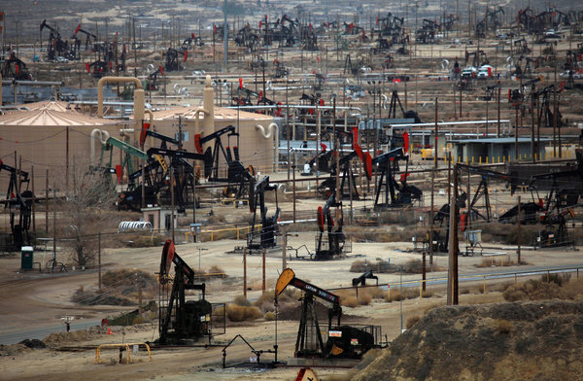
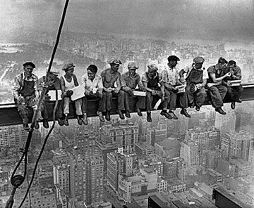
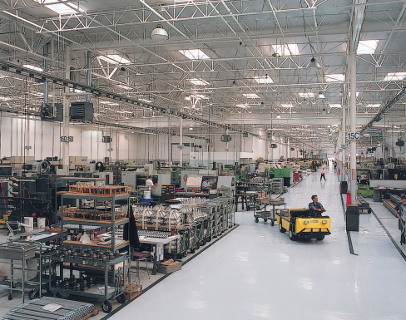


Production Possibilities Frontier (PPF)
The PPF: Demonstrates the maximum attainable combination of two products with a given technology and a given level of “factors of production”.
Factors of Production
1.
2.
3.
4.
5.

Slide 3
Production Possibilities Frontier (PPF)
Example: A small country produces two goods: corn (measured in bushels) and trucks.
 | A | B | C | D | E
Trucks | 0 | 10 | 20 | 30 | 40
Corn | 70 | 60 | 45 | 25 | 0
Corn
Trucks

Slide 4
Production Possibilities Frontier (PPF)
Production is efficient at points on the curve. This implies that the economy is getting all it can from its available scarce resources.
Production at a point inside the curve is inefficient.
Production at a point outside of the curve is not possible given the economy’s current level of resources and technology.
PPFs show the tradeoffs that society faces. These trade-offs are shown by the:

Slide 5
Production Possibilities Frontier (PPF)
The PPF shows the opportunity cost of producing each of the goods. The o.c. of 10 trucks between A and B (from 0 trucks to 10 trucks) is
The o.c. of 10 trucks between B and C (from 10 trucks to 20 trucks) is
The o.c. of 10 trucks between C and D (from 20 trucks to 30 trucks) is
The o.c. of 10 trucks between D and E (from 30 trucks to 40 trucks) is
Note that the opportunity cost of the good on the horizontal axis is shown by the:

Slide 6
Production Possibilities Frontier (PPF)
With a PPF that is bowed outward from the origin (“concave”), what happens to the opportunity cost of trucks (in terms of corn) as the country produces more trucks and fewer bushels of corn?
Why does this happen?
What does that mean?
What would a PPF look like if resources were equally well-suited to the production of both goods?

Slide 7
PPF and Economic Growth
“Outward” shifts in the PPF represent economic growth as output increases.
A general increase in technology or an increase in one or more of the factors of production will:
Shift the entire PPF “outward” resulting in a potential increase of both goods.
MP3 Players
•A
Donuts

Slide 8
PPF and Economic Growth
An increase in technology in the production of donuts will only shift the PPF along the horizontal axis.
This will not affect the maximum output of the good on the vertical axis.
This technological increase can lead to an increase in the output of both goods.
MP3 Players
•A
Donuts

Slide 9
PPF and Inward Shifts
Consider a production possibilities frontier that shows the trade-off between the production of cotton and the production of soybeans.
Show the effect that a prolonged drought would have on the PPF.
In general, what causes this kind of shift of the PPF?
Cotton
•A
Soybeans

Slide 10
PPFs and Inefficiency
Draw a production possibilities frontier that shows the trade-off between the production of cotton and the production of soybeans.
Show the effects of an inefficiency in the economy that results in unemployment of workers and resources.
Cotton
•A
Soybeans

Slide 11
Comparative Advantage and Trade
Think of all of the goods and services that you consume that you do not directly produce.
Why don’t you produce all of your own goods and not trade with other people?
Instead of producing all of our own goods, what do we do?
Does this behavior make us better off?
“Man is the only animal that makes bargains: one dog does not exchange bones with another dog.” -- Adam Smith

Slide 12
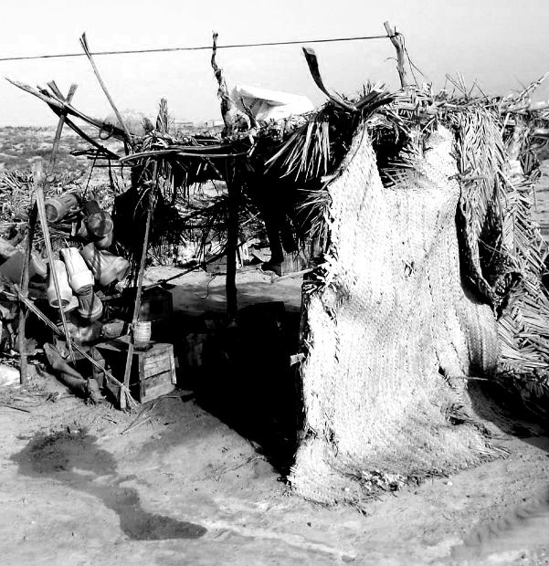
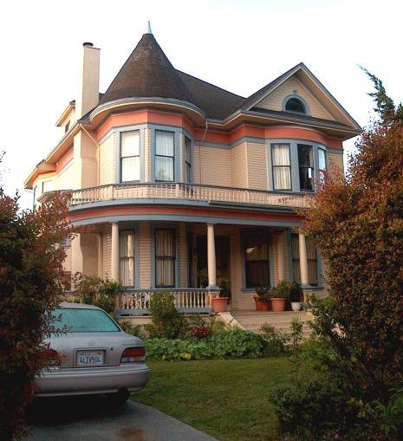
Trade allows us all to consume more than we otherwise could….
Other things equal, are you better or worse off when someone else makes your house?

Slide 13
 | YOU |  | YOUR NEIGHBOR
 | APPLES (IN POUNDS) | CHERRIES (IN POUNDS) | APPLES (IN POUNDS) | CHERRIES (IN POUNDS)
Devote all time to picking apples | 60 | 0 | 24 | 0
Devote all time to picking cherries | 0 | 120 | 0 | 72
Absolute advantage The ability of an individual, a firm, or a country to produce more of a good or service than competitors, using the same amount of resources.
Who has absolute advantage in apple picking?
Who has absolute advantage in cherry picking?

Slide 14
Your PPF
Apples
Cherries

Slide 15
Your Neighbor’s PPF
Apples
Cherries

Slide 16
Calculating Opportunity Cost
Your opportunity cost of picking one lb of cherries is:
Your opportunity cost of picking one lb of apples is:
Your neighbor’s opportunity cost of picking one lb of cherries is:
Your neighbor’s opportunity cost of picking one lb of apples is:
Who has the lowest opportunity cost of cherry picking?
Who has the lowest opportunity cost of apple picking?

Slide 17
Comparative advantage The ability of an individual, a firm, or a country to produce a good or service at a lower opportunity cost than competitors.
Both parties can be made better off by specializing in the good for which they hold the comparative advantage and then trading with one another. Thus you should specialize in apples and your neighbor should specialize in cherries.
There is a range of “terms of trade” that will be mutually beneficial. Assume that you send your neighbor 19 apples and she sends you 47 cherries.
Your Opp Cost: 1 apple equals 2 cherries => Ratio: 1/2 = 0.50
Terms of Trade: 19 apples for 47 cherries => Ratio: 19/47 = 0.40
Neighbor’s O.C.: 1 apple equals 3 cherries => Ratio: 1/3 = 0.33

Slide 18
Below we summarize the specialization and trade
 | YOU |  | YOUR NEIGHBOR
 | APPLES (IN POUNDS) | CHERRIES (IN POUNDS) | APPLES (IN POUNDS) | CHERRIES (IN POUNDS)
Production and consumption without trade | 40 | 40 | 18 | 18
Production with trade | 60 | 0 | 0 | 72
Trade | -19 | +47 | +19 | -47
Consumption with trade
Gains from trade (increased consumption)

Slide 19
Comparative Advantage and Trade Summary
The basis for trade is comparative advantage,
Individuals, firms, and countries are better off if they specialize in producing goods and services for which they have a comparative advantage and obtain the other goods and services they need by
Specializing and trading allows
Is it possible for an individual to have absolute advantage in everything?
Is it possible for an individual to have comparative advantage in everything?

Slide 20
Applications of Comparative Advantage
Another quote from Adam Smith: “It is the maxim of every prudent master of a family, never to attempt to make at home what it will cost him more to make than buy.”

Slide 21
Product and Factor Markets
Most trades are not direct, but instead occur in:
Two key groups operating in markets: firms and households
Product markets are markets for goods and services.
Factor markets are markets for factors of production
Labor
Capital
Natural Resources
Entrepreneurial ability

